Slide 1
RESERVOIR Service Manager
NickTsouroulas (nik@tid.es)
Head of Open-Source Reference Implementations Unit
Juan Cáceres (caceres@tid.es)
Project Manager
Telefónica R&D
  The research leading to these results has received funding from the European
  Community's Seventh FrameworkProgramme (FP7/2007-2013) under grant agreement n° 215605.

Slide 2
Index
Introduction
Service Manager Components and Funcionality
R&D Activities

Slide 3
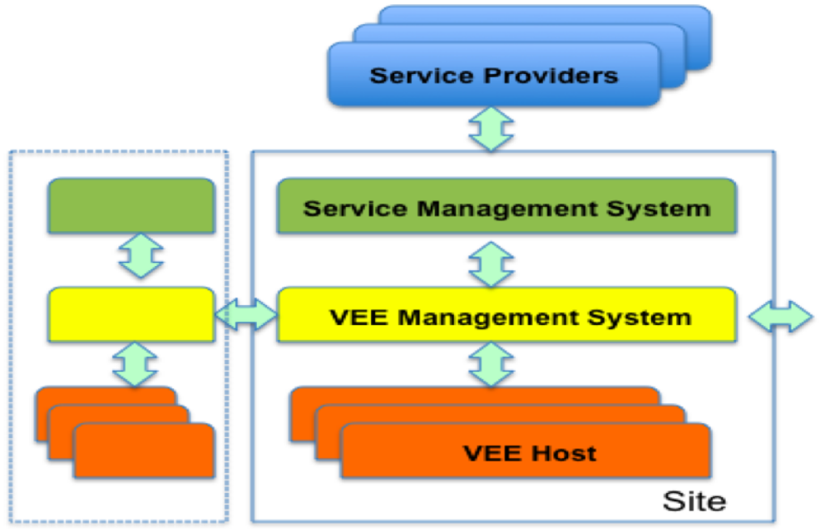
Introduction
The main function of the Service Manager is to deploy Services over a federated RESERVOIR infrastructure, dynamically manage the resource needs of Services according to a target SLA and support a utility-like business model

Slide 4

Service Manager Components and Functionality
Service Definition
Service Providers deploy applications by passing
a Service Definition Manifest to a single infrastructure provider (a single RESERVOIR Site).
A Service Definition Language, developed by RESERVOIR, will be used to create service manifests.
This language will allow the description of:
  The distinct component types, requirements for each component type and logical architecture of the service, initial distribution across VEEs
  Service levels the application can offer to customers and those it requires from infrastructure providers
  Capacity and QoS requirements
  Elasticity Rules: Express how the total application capacity (resource requirements and number of instances of each application component) can be dynamically adapted to properly satisfy the requirements of the application and minimize the cost

Slide 5


Service Manager Components and Functionality
Service Definition
A Service Manifest contains:
  Functional components of the application
  Component grouping instructions
  Component topology instructions
  VEE requirements
  Capacity and QoS Requirements
  Elasticity Rules
  Monitoring Specification
IDE Tool to edit and publish Service Manifests
A Version Control Repository to store different versions of a Service Manifests.

Slide 6

Service Manager Components and Functionality
Service Framework Agreements
Framework Agreements are contracts that formalize the
relationships in the RESERVOIR federated infrastructure:
  Between Infrastructure Providers and Service Providers
  Between Infrastructure Providers
This contract agreement is transformed into Common Data Model, shared by all the components of the RESEVOIR architecture. It includes:
  Resource Catalogue: Defines the type and characteristics of the resources that are under the agreement control (VEE, virtual networks, firewalls, load balancers, etc.)
  SLA Definitions:
    Key Performance Indicators (KPI): For example, RTO (Return to Operation Time) of a VEE or a network link, throughput in operations per second of a service etc.
    SLO and KPI threshold mappings: For example, a SLO named “GOLD” would mean that VEE has a RTO threshold of 5 minutes or that a Service Component throughput is 100 operations per second.
    Business Model Definitions: Costs and accounting directives, other business related aspects.

Slide 7

Service Manager Components and Functionality
SLA Monitoring
SLA Monitoring:
  Once a Service is deployed, monitoring components collect useful data to prevent and detect SLA violations.
Monitoring Mechanisms:
  Non-Intrusive Service Component Probes that gather and process network data
  VEE Monitoring Interface that allows the monitoring components to collect VEE usage statistics (CPU, memory ..)
SLA Protection:
  Components that dynamically detect SLA violations and predict future SLA violations based on historical and heuristic knowledge.
  They generate events that are used by the Lifecycle Components and may trigger the process of reconfiguration of the services when needed in order to resolve problems with SLA fulfillment.

Slide 8






Service Manager Components and Functionality
Life Cycle Management
Orchestrates the Service Manager Components, managing the initial deployment of the Service and the dynamic configuration and redeployment process targeted to protect some SLA objective criteria.
Service Request Dispatching
Load balancing and efficient request dispatching taking into account SLA objectives, cost directives, across all sites in the federated infrastructure.
Accounting Payment and Billing
Support new utility-like business models (pay-per-use schemas), expressed in real business terms (rather than generic ICT usage terms like CPU cycles, storage etc.), dealing with different administrative domains each with its own commercial offers.

Slide 9








R&D Activities:
Service Definition and Lifecycle Management
Objectives
  To define a Service Definition Language and develop tools for the definition of services and management of their lifecycle.
Tasks
  Service Definition Language (includes SLAs)
  Service Definition Tools
  Service Lifecycle Management
Key Results
  A Service Definition Language specification based on virtualized Service Components
  A Service Lifecycle Model specification and tools to manage it
Opportunities
  Contribute to Standardization Bodies (OGF, DMTF, …)
  Contribute to NESSI’s Reference Architecture built by the NEXOF-RA FP7 project

Slide 10




R&D Activities:
SLA Management and Service Request Dispatching
Objectives
  Global SLA Management
    Dynamic, automated and proactive SLA violation detection
    Active monitoring of SLA KPIs through local and remote VEEs
    Proactive resource allocation or de-allocation requests to VEEMS
  Service Request Dispatching
    Targeting replicated service VEEs without boundaries
    Advanced Load Balancing Algorithms with SLA and cost restrictions
    Efficient communication protocols and replication schemas in Java Service Containers
Tasks
Efficient SLA Monitoring
Service Level Protection
Service Request Dispatching

Slide 11




R&D Activities:
SLA Management and Service Request Dispatching
Key Results
Probe-based network monitoring technologies
Proactive SLA risk detection and dynamic Service Reconfiguration technologies
New Load Balancing algorithms based on SLA protection and cost directives
Opportunities
  New Service Management and Monitoring Technologies

Slide 12




R&D Activities:
Business-oriented Accounting, Payment and Billing
Objectives
  Provide a framework for business governance and a holistic view on services and the infrastructure used to host them.
  Development of a utility-computing business model (pay-per-use) in a federated infrastructure schema
  Accounting and billing of resource use, SLA violation penalties, flexible commercial offerings
Tasks
  Business Information Model
  Components for accounting of service usage
  Business oriented payment and billing mechanisms

Slide 13




R&D Activities:
Business-oriented Accounting, Payment and Billing
Key Results
An advanced business information model that captures all the billable assets and describes the business relations between infrastructure and service providers
Design and implementation of a complete accounting system in charge of integrating billing management processes with the other RESERVOIR components
Design and implementation of a business management tool based on business rules and open to dynamic business models
Opportunities
  Advance technologies necessary in order to explore new business opportunities in the grid / virtualization infrastructures area.

Slide 14
Thanks!!!!

